Slide 1
Network Hardware and its
Topologies
CSE306

Slide 2
Categories of Networks
Personal area networks
Local Area networks
Metropolitan Area networks
Wide Area networks
Wireless Networks
Home Networks
Internetworks- The Internet

Slide 3
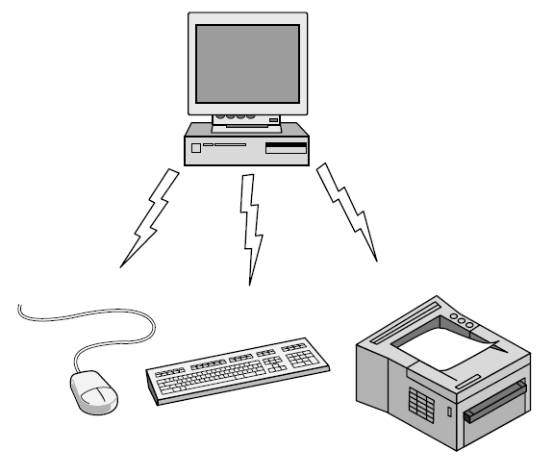
Personal Area Network
Bluetooth PAN configuration

Slide 4
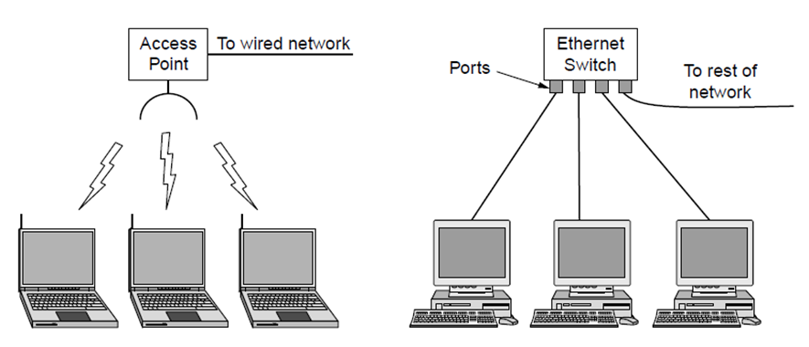
Local Area Networks (LANs)
  Short distances
  Designed to provide local interconnectivity
Wireless and wired LANs. (a) 802.11. (b) Switched Ethernet.

Slide 5
Wide Area Networks (WANs)
  Long distances
  Provide connectivity over large areas

Slide 6

WANs: a switched WAN and a point-to-point WAN

Slide 7

A heterogeneous network made of four WANs and two LANs
1.<number>
Notes:
1.#

Slide 8
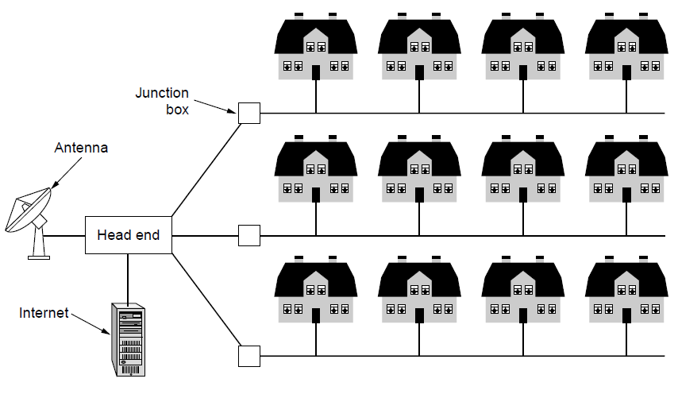
Metropolitan Area Networks (MANs)
  Provide connectivity over areas such as a city, a campus
A metropolitan area network based on cable TV or telephone cable using DSL

Slide 9
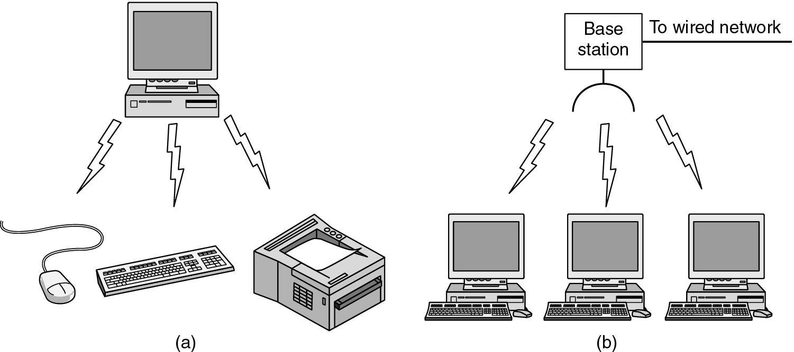
Wireless Networks
(a) Bluetooth configuration
(b) Wireless LAN

Slide 10
Home Network Categories
Computers (desktop PC, PDA, shared peripherals
Entertainment (TV, DVD, VCR, camera, stereo, MP3)
Telecomm (telephone, cell phone, intercom, fax)
Appliances (microwave, fridge, clock, furnace, airco)
Telemetry (utility meter, burglar alarm, babycam).

Slide 11
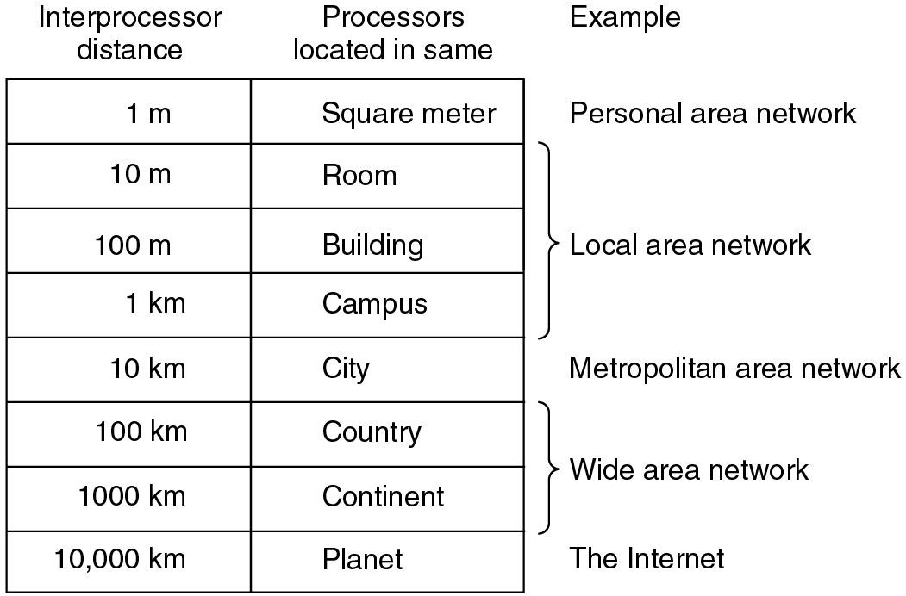
Broadcast Networks
Classification of interconnected processors by scale.

Slide 12
Network Topology
The topology of a network defines how the nodes of a network are connected.
The shape of the cabling layout used to link devices is called the physical topology of the network.
The logical topology, in contrast, is the way that the signals act on the network media, or the way that the data passes through the network from one device to the next without regard to the physical interconnection of the devices.

Slide 13
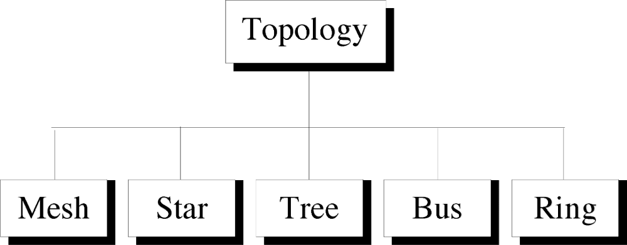
Categories of Physical Topology

Slide 14
Mesh Topology
Here every device has a point to point link to every other device.
Node 1 node must be connected with n-1 nodes.
A fully connected mesh can have n(n-1)/2 physical channels to link n devices.
It must have n-1 I/O ports.

Slide 15

A fully connected mesh topology (five devices)
1.<number>
Notes:
1.#

Slide 16
Advantages of Mesh
They use dedicated links so each link can only carry its own data load. So traffic problem can be avoided.
It is robust. If any one link get damaged it cannot affect others.
It gives privacy and security.(Message travels along a dedicated link)
Fault identification and fault isolation are easy.

Slide 17
Disadvantages of Mesh
The amount of cabling and the number of I/O ports required are very large. Since every device is connected to each devices through dedicated links.
The sheer bulk of wiring is larger then the available space.
Hardware required to connected each device is highly expensive.

Slide 18
Applications of Mesh
Telephone Regional office.
WAN.(Wide Area Network).

Slide 19
Star Topology
Here each device has a dedicated point-to-point link to the central controller called “Hub”(Act as a Exchange).
There is no direct traffic between devices.
The transmission are occurred only through the central “hub”.
When device 1 wants to send data to device 2; First sends the data to hub. Which then relays the data to the other connected device.

Slide 20

Star Topology

Slide 21
Advantages of Star Topology
Less expensive then mesh since each device is connected only to the hub.
Installation and configuration are easy.
Less cabling is need then mesh.
Robustness.(if one link fails, only that links is affected. All other links remain active)
Easy to fault identification & to remove parts.
No distruptions to the network then connecting(or) removing devices.

Slide 22
Disadvantages of Star Topology
Even it requires less cabling then mesh when compared with other topologies it still large.(Ring or bus).
Dependency(whole n/w dependent on one single point(hub). When it goes down. The whole system is dead.

Slide 23
Applications of Star Topology
Star topology used in Local Area Networks(LANs).
High speed LAN often used STAR.

Slide 24
Bus Topology
A bus topology is multipoint.
Here one long cable act as a backbone to link all the devices are connected to the backbone by drop lines and taps.
Drop line- is the connection b/w the devices and the cable.
Tap- is the splitter that cut the main link.
This allows only one device to transmit at a time.

Slide 25

Bus Topology

Slide 26
When a device sends a message, it is broadcast down on the cable in both directions. Terminators at the end of the cable prevent the signal from reflecting back to the sender.
All devices on the cable constantly monitor for messages meant to them. When a device detects a message meant for it, it reads the message from the cable and the other devices will ignore it.
Since all devices are sharing the same cable, some form of control is needed to make sure which device will transmit when, otherwise there will be a collision.

Slide 27
Advantages of Bus Topology
Ease of installation.
Less cabling.
less expensive.

Slide 28
Disadvantages of Bus Topology
Difficult reconfiguration and fault isolation.
Difficult to add new devices.
Signal reflection at top can degradation in quality.
If any fault in backbone can stops all transmission.

Slide 29
Applications of Bus Topology
Most computer motherboard.

Slide 30
Ring Topology
Here each device has a dedicated connection with two devices on either side.
The signal is passed in one direction from device to device until it reaches the destination and each device have repeater.
When one device received signals instead of intended another device, its repeater then regenerates the data and passes them along.
To add or delete a device requires changing only two connections.

Slide 31

Ring Topology

Slide 32
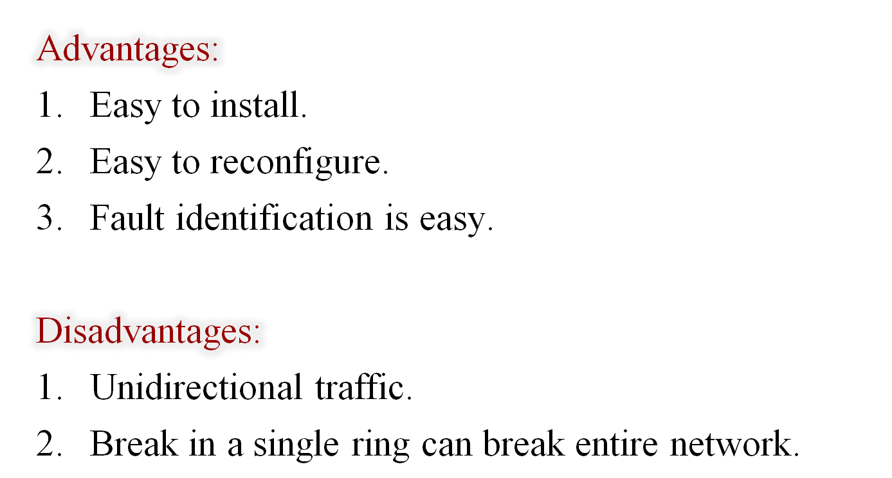
Ring Topology

Slide 33
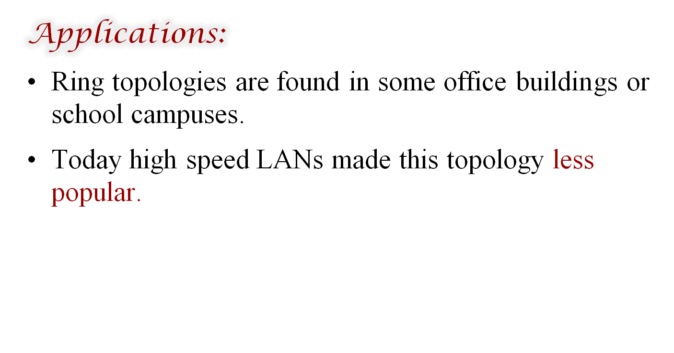
Ring Topology

Slide 34
Tree Topology
Alternatively referred to as a star bus topology.
Tree topology is one of the most common network setups that is similar to a bus topology and a star topology.
A tree topology connects multiple star networks to other star networks. Below is a visual example of a simple computer setup on a network using the star topology.

Slide 35
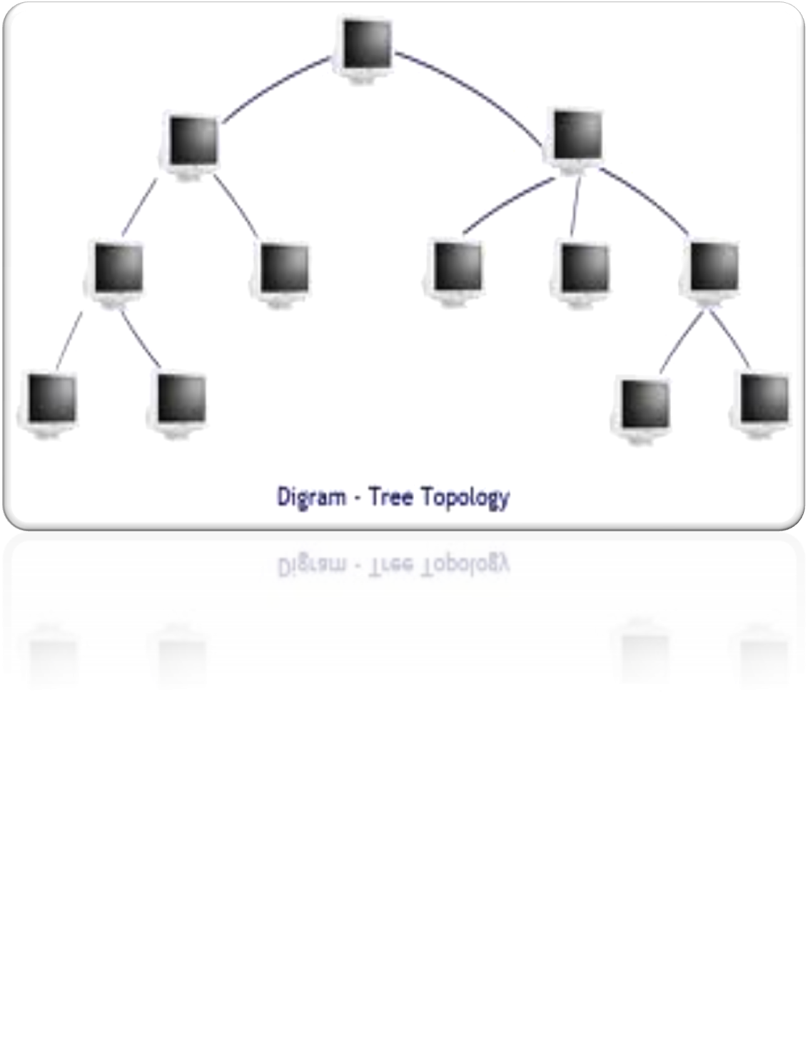

Slide 36
Hybrid Topology
A network which contain all type of physical structure and connected under a single backbone channel.

Slide 37
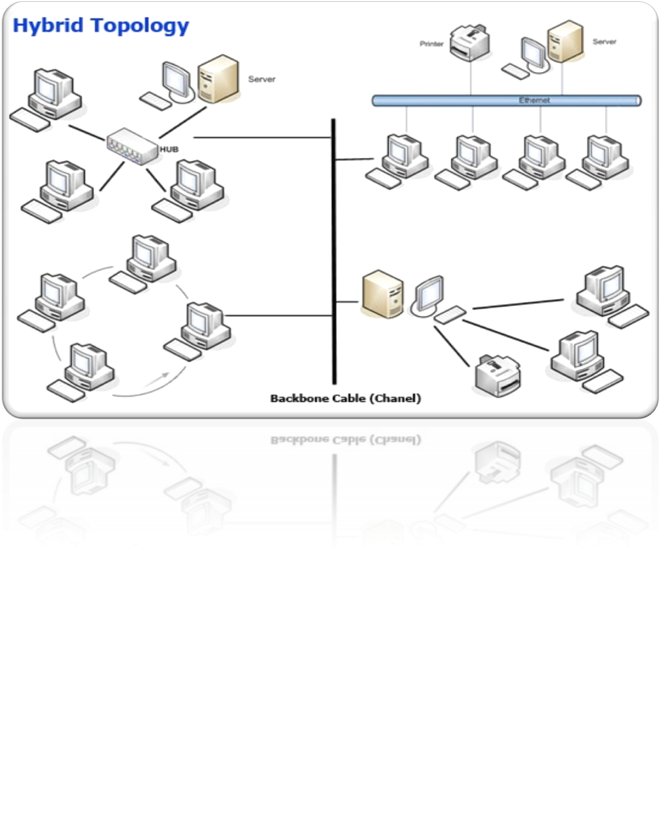

Slide 38

Hybrid Topology

Slide 39
Considerations for Choosing Network Topology
Money-Bus n/w may be the least expensive way to install a n/w.
Length-of cable needed- the linear bus n/w uses shorter lengths of cable.
Future growth-with star topology, expending a n/w is easily done by adding another devices.
Cable type-most common used cable in commercial organization is twisted pair. Which is often used with star topologies.

Slide 40
Full mesh topology is theoretically the best since every device is connected to every other device.(thus maximizing speed and security. however, it quite expensive to install)
Next best would be tree topology , which is basically a connection of star.

Slide 41
Backbone Networks: Serial Backbone
Daisy chain: linked series of devices
  Hubs and switches often connected in daisy chain to extend a network
Hubs, gateways, routers, switches, and bridges can form part of backbone
Extent to which hubs can be connected is limited

Slide 42
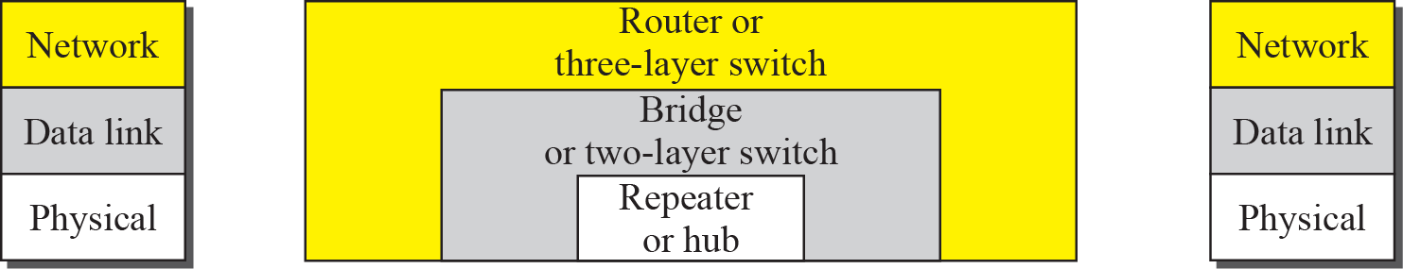
Connecting devices

Slide 43
Repeater or hub
A repeater forwards every bit; it has no filtering capability.

Slide 44
A router is a three-layer (physical, data link, and network) device.

Slide 45
A repeater or a bridge connects segments of a LAN.
A router connects independent LANs or WANs to create an internetwork (internet).

Slide 46
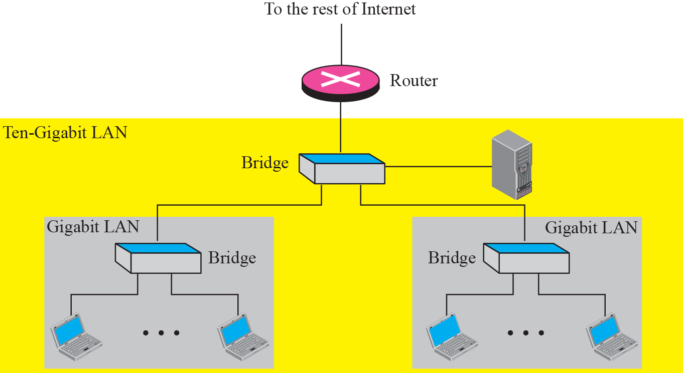
Routing example

Slide 47
Hub
Broadcast
More collision
Connect same networking device

Slide 48
Switch
Switch is intelligent device
Learning the address
Forwarding
Work on mac address

Slide 49
Router
Connect different networks
Routing

